Slide 1



Machine Learning and Causal Inference approaches for systemic multi-disease associations in UK Biobank
Alejandro González Álvarez

Slide 2

Problem statement
Neurocardiology: specialty which was born with the goal
of studying and understanding the pathophysiological interplay of the nervous and cardiovascular systems.
Cardiology vs neurology. Classical diagnosis and treatment approaches of illnesses have been treated as differentiated and isolated specialties.
Multi-organ disease association. Many observational studies have supported the clinical relevance of multi-organ disease association.
These associations have been established largely on the
basis of epidemiological data, due to insufficient knowledge on the underlying pathophysiologic mechanisms.

Slide 3
2. Related work
Plenty of studies have looked at the relationships between heart structure,
brain structure and vascular health individually
Vascular Health
1. Phloyngam (2019)
2. Cetin et al. (2020)
3
1. Cox et al. (2019)
2. Gorelick and Sorond (2018)
2
Heart Structure
Brain
Structure
1
1. Bruns (2017)
2. Jefferson et al. (2010)

Slide 4
2.1 Our approach
2.1.1 Traditional ML with Separate Models
2.1.2 Traditional ML with Joint Model
CMR Radiomics
(639 Features)
CMR Radiomics
(639 Features)
Aggregate measure of vascular risk and latent factor
Aggregate measure of vascular risk and latent factor
Brain Structural MRI
(744 Features)
Brain Structural MRI
(744 Features)
In previous work, connections and associations were studied independently. Our approach attempts to study them simultaneously.
Initial hypothesis: brain MRI indices and heart radiomics are independent and provide unique information, therefore together they will improve performance.

Slide 5
2.1.3 Causal Inference techniques
Vascular Health
Heart Structure
Brain
Structure
If our initial hypothesis fails and performance does not improve, it will mean that both datasets do not provide unique information and as a result they might be similar and somehow correlated.
Therefore, the relationship between them will be high. Causal Inference techniques pretend to find this link between them.

Slide 6
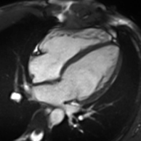
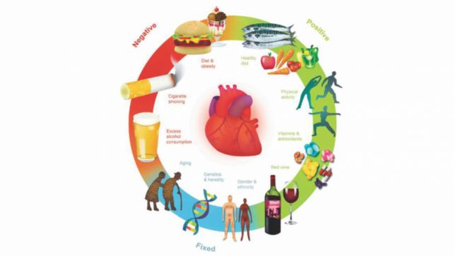
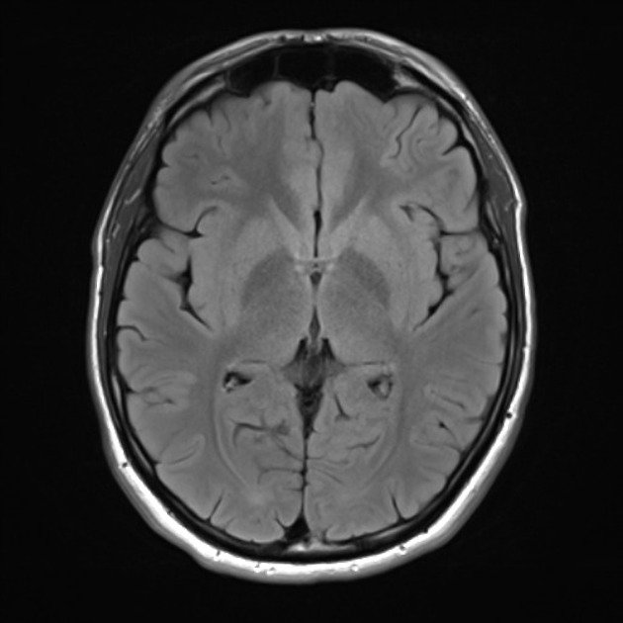
3. Datasets description
2065 UK Biobank Patients and 1416 variables
3.1 Heart CMR Radiomics
3.2 VRFs
3.3 Brain MRI Indices
Heart imaging derived data that quantifies various changes in heart structures
Cardiovascular risk factors that capture how well the heart works
Brain structural imaging data that contains the structure of various brain regions

Slide 7
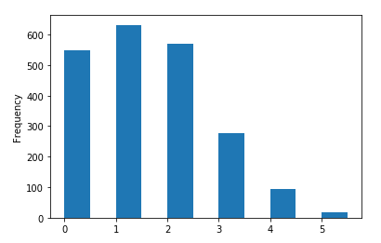
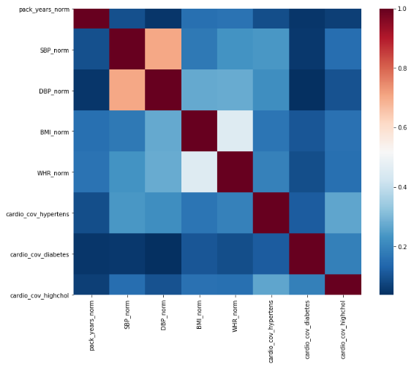
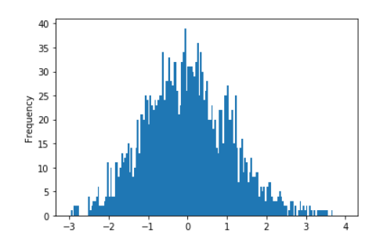
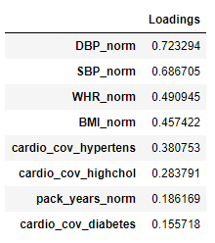
4. Dimensionality reduction
Cardiovascular risk factors
4.1 Aggregate measure
Aggregate measure of vascular risk
Latent factor
(gVRF)
Counting instances of a self-reported diagnosis of hypertension, diabetes, or hypercholesterolaemia, having ever smoked, having a BMI >25, and having a high WHR (>0.85 for females and >0.90 for males).
We also derived a latent factor of general vascular risk (gVRF). It was derived from smoking pack years, diastolic and systolic blood pressure, BMI, WHR, self-reported hypertension, diabetes and hypercholesterolaemia.
4.2 gVRF

Slide 8
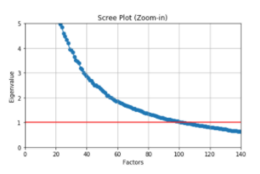
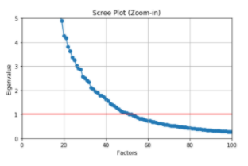
Brain Structural MRI
Heart CMR Radiomics
Features | # Variables | KMO Score | Bartlett's test | Scree test
gVRF | 8 | 0,6418 | (2719.71, 0) | 3
Brain MRI Indices | 744 | 0.9526 | (inf, nan) | 100
Heart CMR Radiomics | 639 | 0.9781 | (inf, nan) | 50

Slide 9
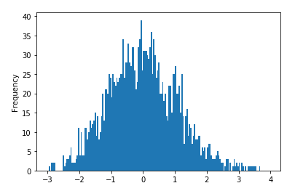
5. Machine Learning approaches
5.1 Predicting gVRF
5.2 Predicting Aggregate measure
from sklearn.linear_model import LinearRegression
from sklearn.ensemble import RandomForest
Evaluation of performance
R^2: coefficient of determination, regression score function.
MAPE: mean absolute percentage error.
MAE: mean of the absolute value of the errors.
MSE: mean of the squared errors.
RMSE: square root of the mean of the squared errors.
Evaluation of performance
Accuracy.
Confusion matrix.
ROC curve.
AUC.

Slide 10
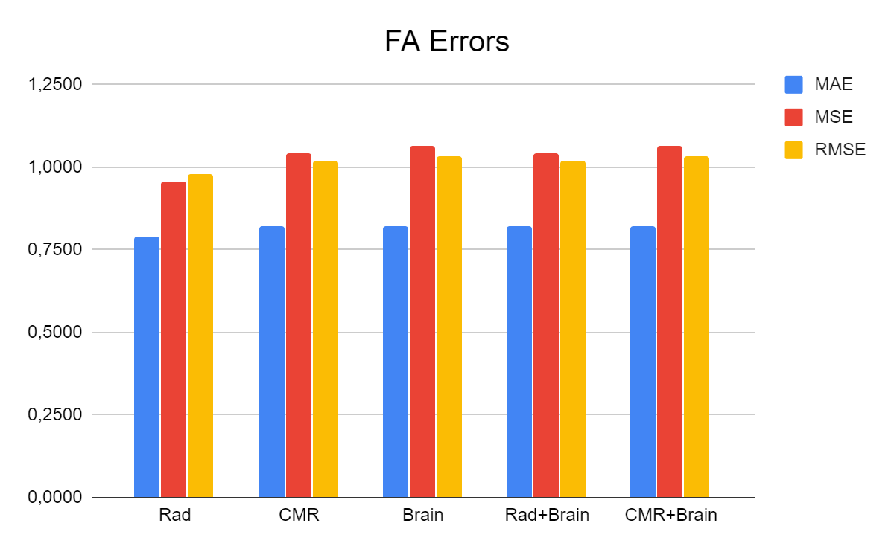
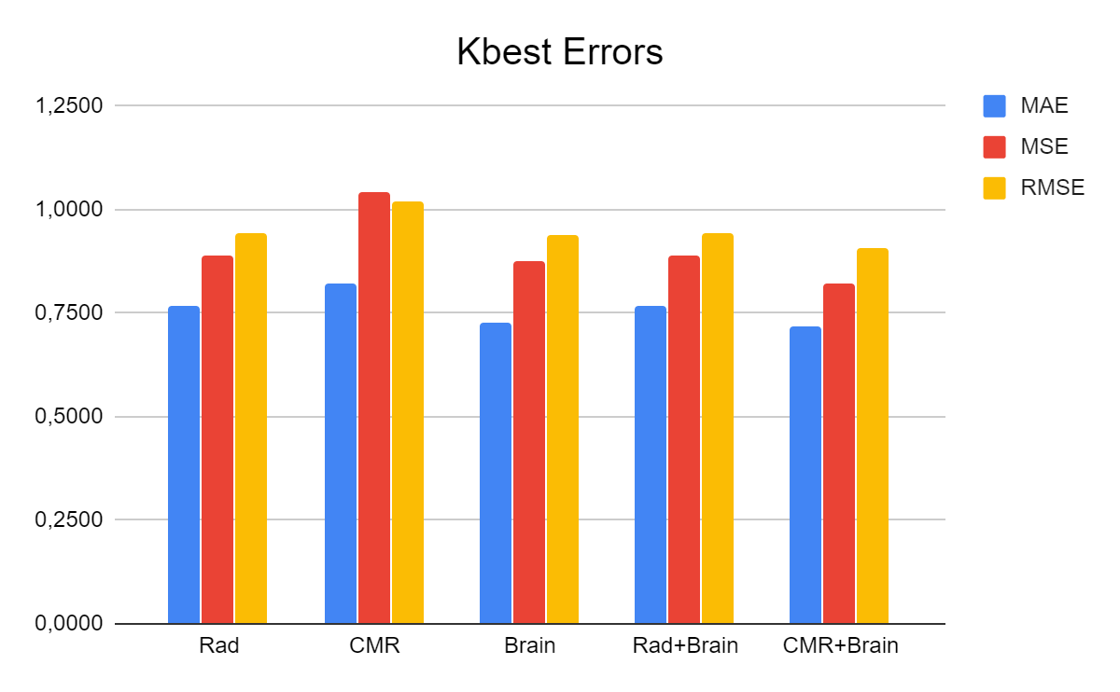
5.1 Predicting gVRF
Best results are obtained with heart radiomics in case of FA, and brain MRI indices and its combination with cardio CMR in case of SelectKbest feature selection
However, overall, the combination of these datasets does not seem to improve at all, or improve very little our performance metrics, which may lead us to reject our initial hypothesis

Slide 11
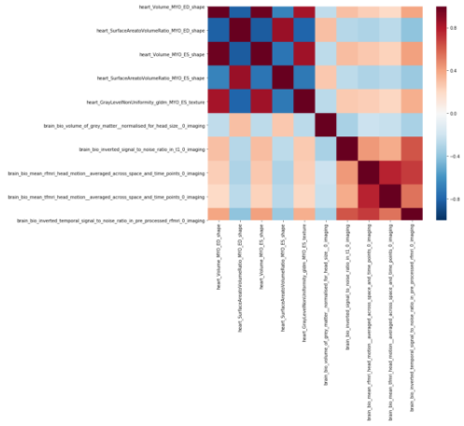
Correlation plot between the 5 SelectKBest selected features from the heart and brain datasets, in which a correlation (in the range -0.4-0.4) can be seen between heart and brain features

Slide 12

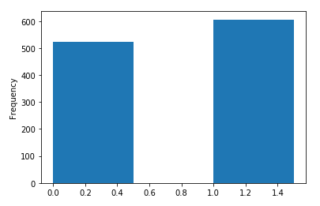
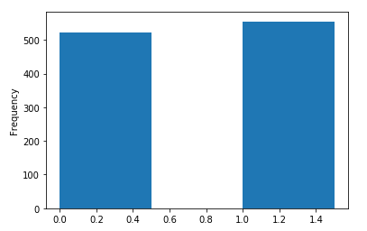
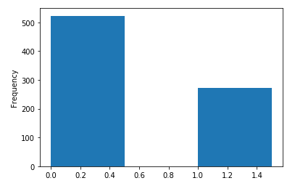
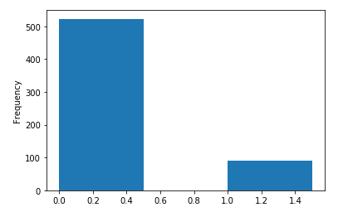
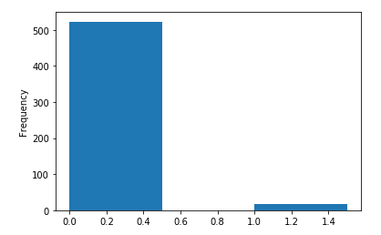
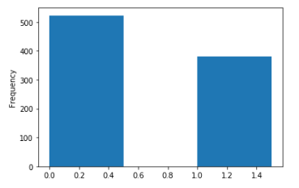
5.2 Predicting aggregate measure of vascular risk
Multiclass classification problem
Binarize classes:
Random oversampling
Random undersampling
SMOTE-Tomek
0vs1
0vs2
0vs3
0vs4
0vs5
0vs3,4,5

Slide 13
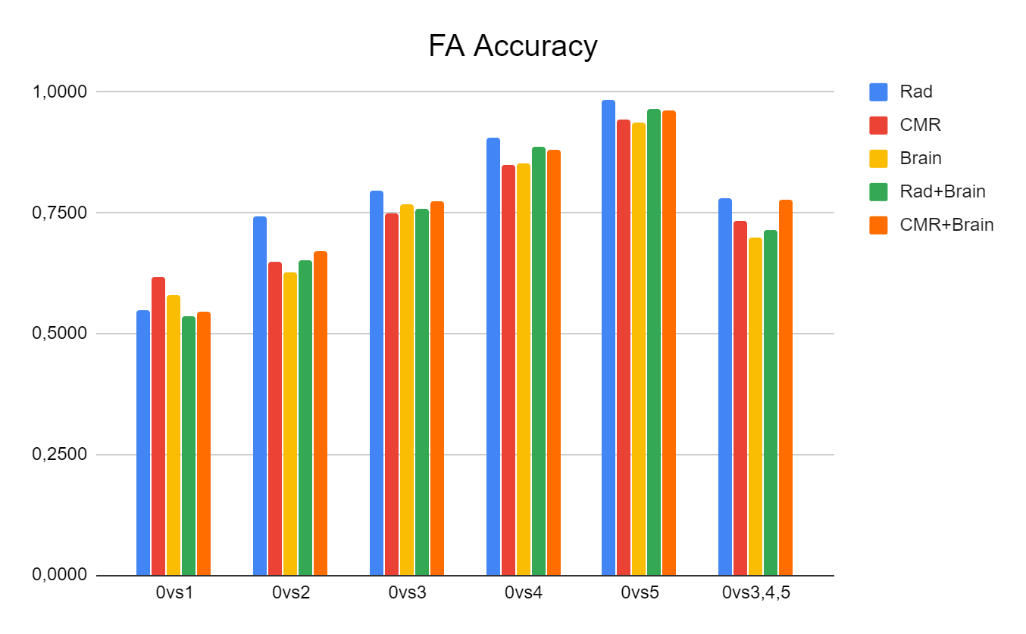
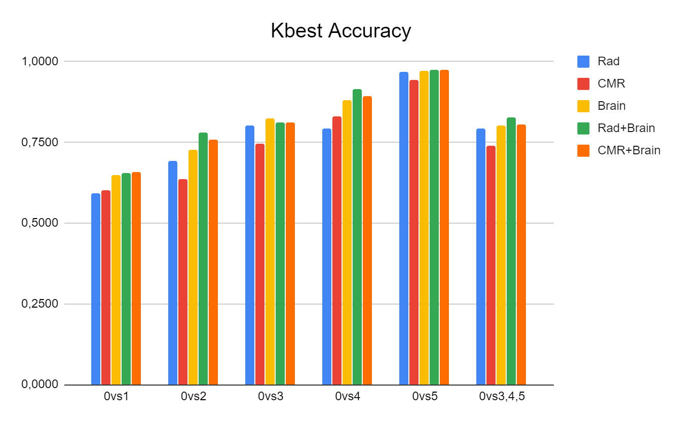
The main trend is that model accuracy and AUC improves as VRFs burden increases.
Combined effects of risk factors seem to be better detected by:
Heart CMR radiomics when using FA as the dimensionality reduction technique.
Brain MRI indices when using SelectKBest as the dimensionality reduction technique.
Again, as it happened when predicting gVRF, the combination of heart and brain datasets does not seem to improve at all, or improve very little our performance metrics, which may lead us to reject our initial hypothesis.

Slide 14
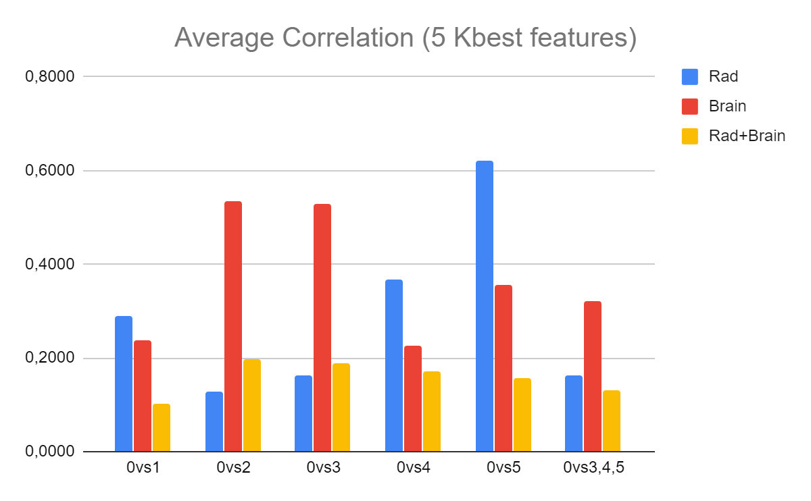
The average correlation between the top 5 SelectKBest features from each dataset seems to be very low and not significant, so we cannot infer yet that these datasets do not provide unique information

Slide 15
5.3 K-means clustering
The multiclass classification task did not work.
Model accuracy and AUC improved as VRFs burden increased.
These results reinforce the hypothesis mentioned earlier that different classes in our aggregate measure might be increasingly different as the number of vascular risk factors increases.
Patients with zero VRFs, the most healthy ones, and patients with five VRFs, the most at risk, seemed to be the most differentiated ones.
To measure the distance between classes we ran the K-means clustering algorithm and computed the centroids for each class.

Slide 16
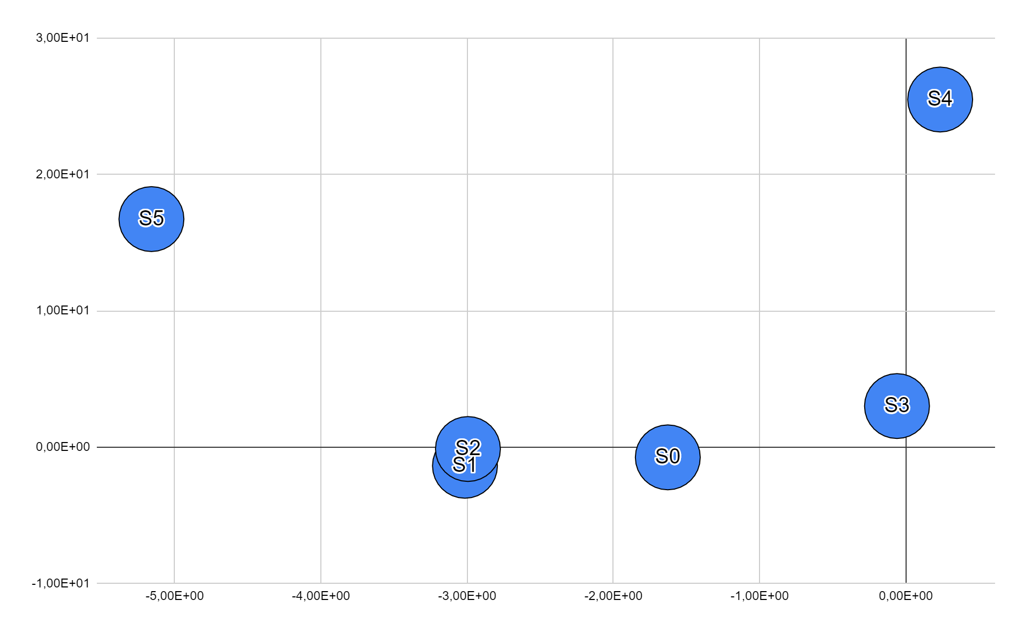
S5, patients with an aggregate score of five, and S0, patients with an aggregate score of zero, are the most distant ones, reinforcing our hypothesis that these two classes differ the most.
S1, S2 and S3 are the closest aggregate measures to S0, showing why these comparisons obtained the lowest performance metrics and why they are the most similar classes from our target variable.

Slide 17
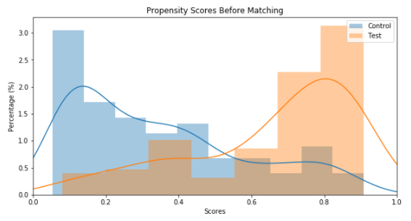

6. Propensity score matching analysis
Individuals with a total of 4 and 5 VRFs were each matched on sex and age
to a single participant who had no VRFs
The average accuracy of our 100 models is 75.9%, suggesting that there’s separability within our data and justifying the need for the matching procedure
The plot above demonstrates the separability present in our data. Test profiles (patients with four and five VRFs) have a much higher propensity, or estimated probability of defaulting than the control group (patients with zero VRFs), given the features we isolated in the data

Slide 18
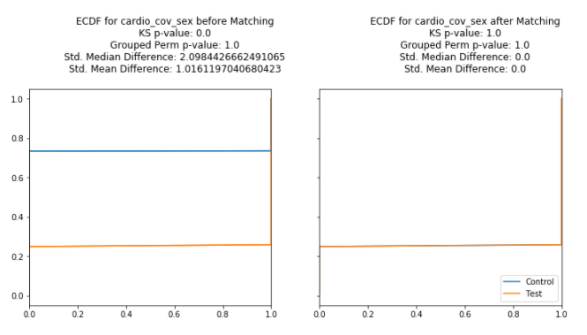
Kolmogorov-Smirnov Goodness of fit Test (KS-test). This test statistic is calculated on 1000 permuted samples of the data, generating an empirical p-value.
Chi-Square Distance. Similarly this distance metric is calculated on 1000 permuted samples.
Standardized mean and median differences

Slide 19
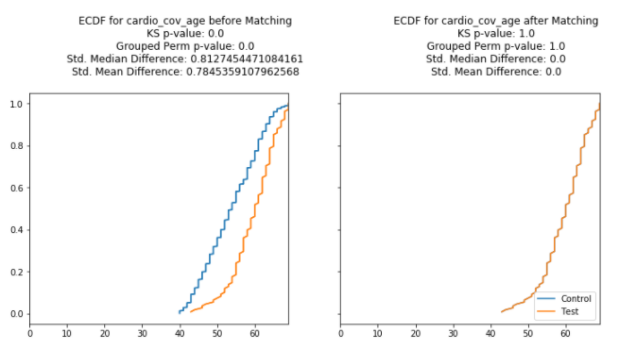
Both lines are very close to each other for both of our covariates (sex and age),
and even indistinguishable after matching
p values from both the KS-test and the grouped permutation of the Chi-Square distance after matching are above 0.05, meaning they were statistically significant

Slide 20
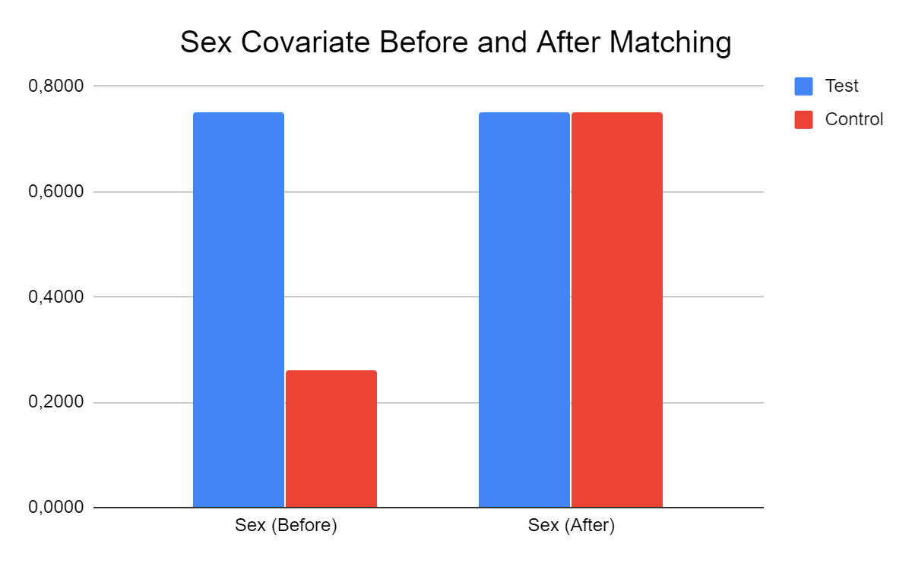
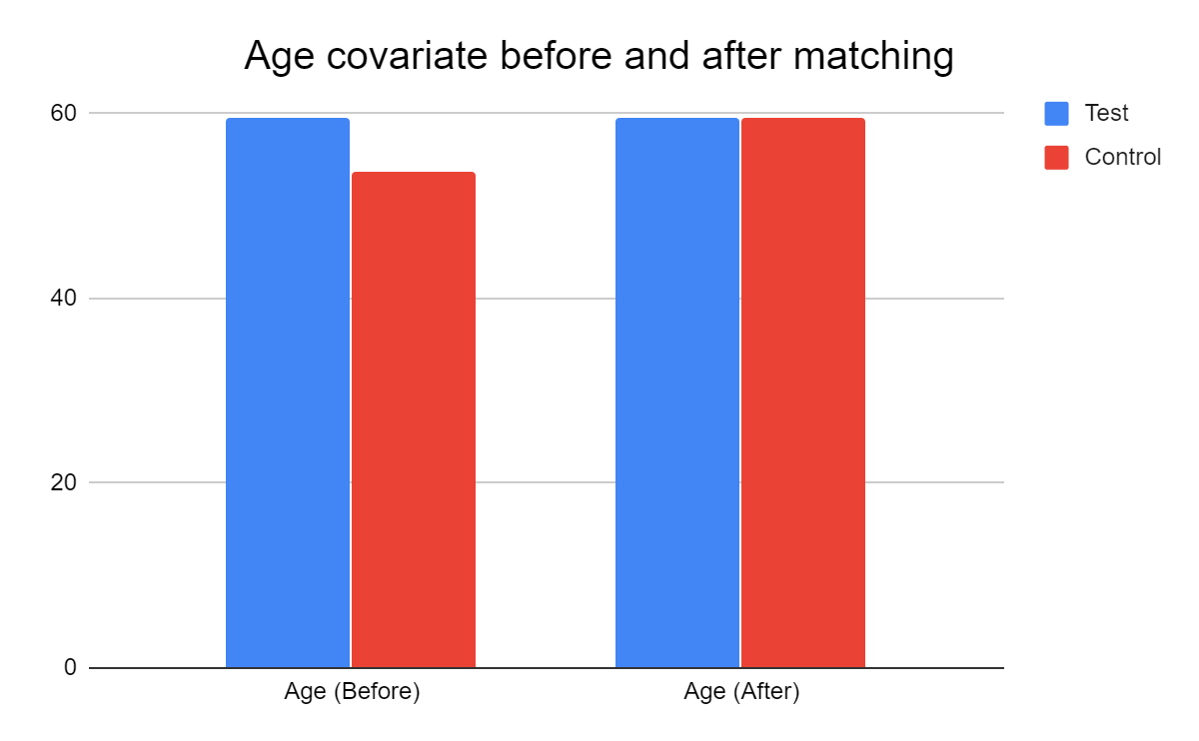
Mean distributions for age and sex before and after matching for both our control and test groups
Before matching, there are more males than females in the test group (patients with four and five VRFs).
The age mean for the test group (59.58) before matching is higher than the control group (53.79).

Slide 21
* Summary so far...
Combination of brain and heart structure’ datasets did not improve when trying to predict vascular health.
We may reject our initial hypothesis, since these datasets may NOT provide unique information, and somehow they are related.
Combined effects of risk factors were better predicted by heart CMR radiomics when using FA as the dimensionality reduction technique.
Combined effects of risk factors were better detected by brain MRI indices when using SelectKBest as the dimensionality reduction technique.
Direct link between VRFs and brain structure?
Direct link between VRFs and heart structure?
An intermediate factor is playing a mediating role between these associations?

Slide 22
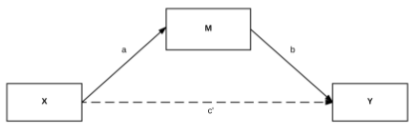
7. Causal Inference techniques (Mediation Analysis)
a and b reflect the indirect path of the effect of X on the outcome (Y ) through the mediator (M ).
c’ is the direct effect of X on the outcome after the indirect path has been removed.
The total effect of X is the combined indirect and direct effects.
ACME (average causal mediation effect): Total effect minus the direct effect (TE - ADE).
ADE (average direct effect) : A direct effect of X on Y after taking into account a mediation indirect effect of M (X + M → Y).
TE (total effect) (indirect + direct effect): A total effect of X on Y (without M) (X → Y).

Slide 23
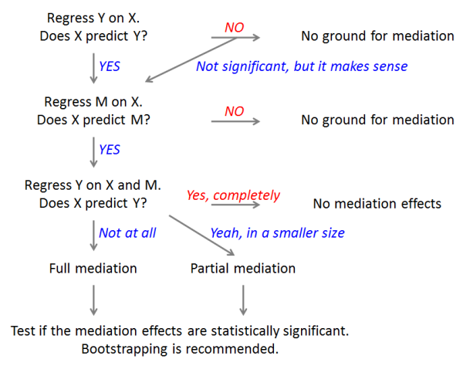
A mediation analysis is comprised of three sets of regressions:
X → Y, X → M, and X + M → Y

Slide 24
How much of the connection between cardiovascular risk and heart/brain structure can be explained by changes in brain/heart structure?
Heart Structure (M)
Brain
Structure (M)
X = -0.2485
X = -0.2031
M = -0.0550
X = -0.1895
X = -0.2586
M = -0.0534
ACME: 0.014
ADE: -0.202
TE: -0.188
ACME: 0.010
ADE: -0.259
TE: -0.248
gVRF (X)
Brain
Structure (Y)
gVRF (X)
Heart Structure (Y)
X = -0.1895
X = -0.2485
VRF → Heart: strongly negatively correlated
VRF → Brain: strongly negatively correlated
Heart → Brain: weakly negatively correlated

Slide 25
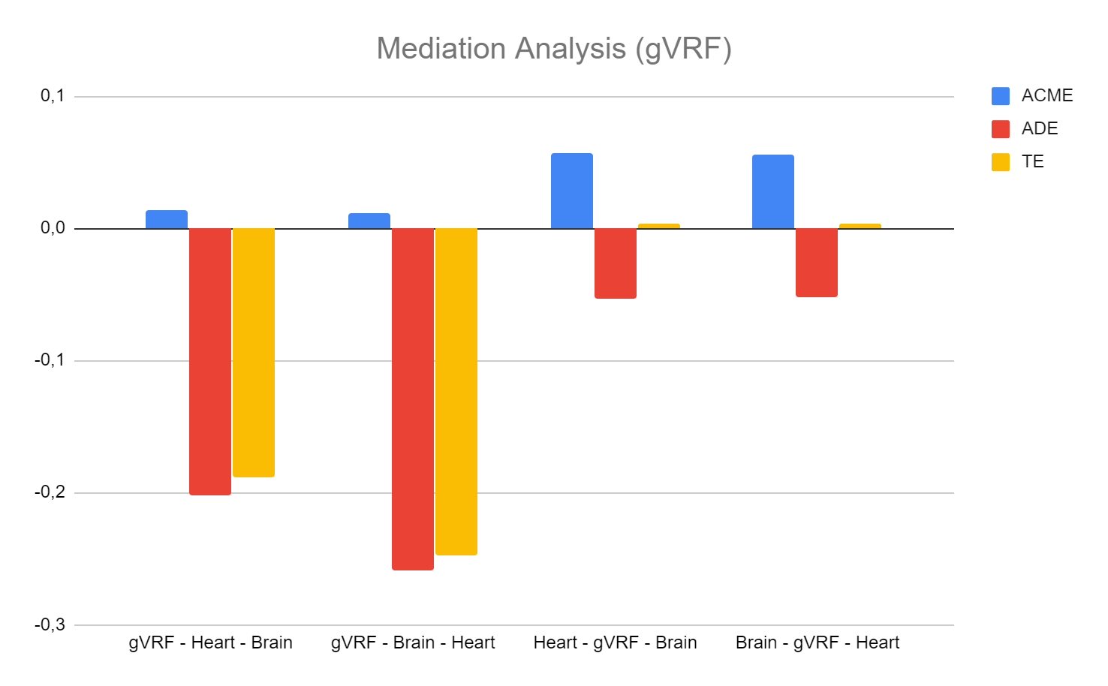
Strongest (-) direct effect: VRF → Heart
Small mediation role of heart and brain (small but significant relationship)

Slide 26
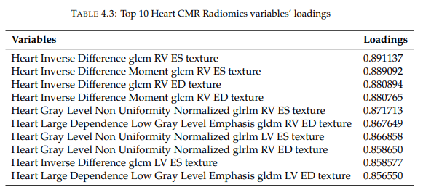
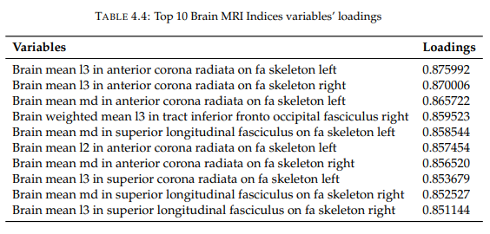
What these factors and negative correlations mean?

Slide 27
8. Discussion and Future Work
Combination of features did not improve performance, but we only used a subset of features from each dataset (5 SelectKBest features and 5 latent factors) for comparison purposes.
Correlation was not very high between these subsets of features (maybe with more features involved correlation increases).
Classes in aggregate measure too similar between them. (Better way to measure vascular health?)
Age and sex important role (further analysis needed).
VRF → Heart: strongly negatively correlated.
VRF → Brain: strongly negatively correlated.
Heart Brain: weakly negatively correlated.
Small mediation role of the heart and the brain (which might increase with more features involved).

